Slide 1
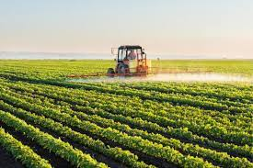
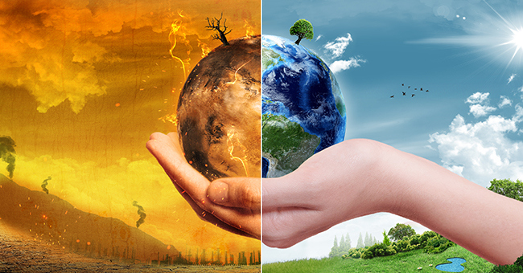
The Impact of Food Production on the Environment
A close look at Food Production’s Impact on:
Eutrophication
Gas Emissions
Temperature
Water
Erik Hoaglund
Joanne Isaac
Max Krueger
Jennifer Puszczewicz

Slide 2


Data Sources
kaggle.com
Food and Agriculture Organization of the United Nations (FAO.org)
World Resources Institute (wri.org)

Slide 3
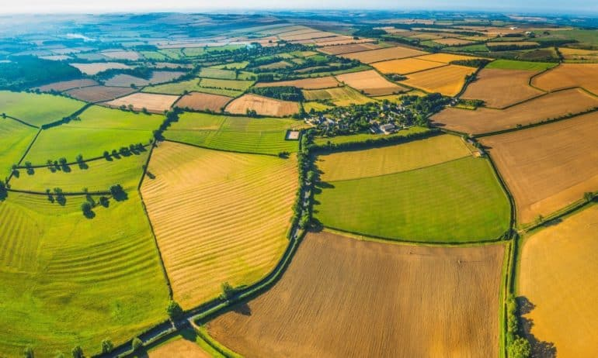
Hypotheses
Food production has a major impact on the environment
The detrimental effect of food production on the environment is dependent on the type of food being produced

Slide 4

Exploratory Questions
How does food production affect the environment?
Which foods have the most detrimental effects on the environment?
Which foods have the least detrimental effects on the environment?
Can food choices impact the environment?

Slide 5


ETL
Datasets in CSV format were downloaded from the sources
Data cleaning was done in Jupyter Notebook
Data was loaded into SQL

Slide 6
Live Demo

Slide 7

Closing Thoughts
Food Production is a major contributor to climate change
Detrimental impacts will become increasingly difficult to abate as the population rises, creating more food demands
Both food and earth are necessary to sustain life, and it is vitally important to recognize how the short-term need for food impacts the long-term need to protect the earth
A move towards a plant-based diet will slow the effects of food production on the environment
Awareness and efforts to decrease food waste will help offset the projected needs for increased food production

